Slide 1
A FLEXDEV COMPANY
PRODUCT DESCRIPTION SHEET
QUICKFLEX REVOLUTION™
THE NEW SUPER-SOFT & WATER-BASED HEAT TRANSFER FILM
LOOKING FOR A QUICK-TO-APPLY HEAT TRANSFER FILM WITH GREAT FEATURES ?
QUICKFLEX REVOLUTION is a water-based PU with a 100% matte finish and super-soft touch, very quick and easy to apply on all types of supports.
3603 Black
3601 White
3624 Grey
3604 Golden Yellow
3613 Lemon Yellow
3605 Orange
3606 Red
3612 Navy bBue
3608 Light Blue
3609 Royal Blue
3625 Light Green
3610 Green
3655 Apple Green
3602 Gold
3623 Silver
3628 Pink
3660 Plum
3632 Fluo pink
3631 Fluo green
3626 Fluo orange
3611 Fluo yellow

Slide 2
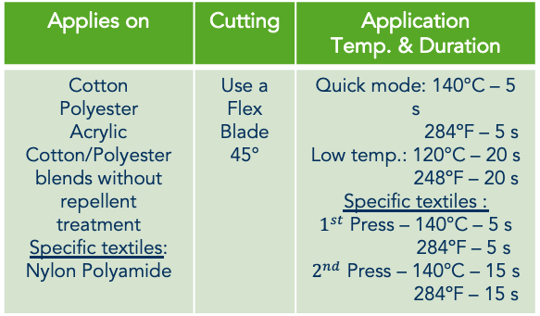
A FLEXDEV COMPANY
TECHNICAL DATA
SPECIFICATIONS
Composition | Average Thickness | Carrier | Size | Certifications
Water-based PU Zero solvent | 90 µm | Medium-tack clear Polyester | Only available in (Ref. 3601, 3603): 30/50 cm x 20 m Only available in (Ref. 3655): 50 cm x 5 m Available in (all other references): 30 cm x 10 m + 50 cm x 20 m | Class I Class II (Ref. 3602)
APPLICATION INSTRUCTIONS
For Cotton – Polyester - Acrylic – Cotton/Polyester blend without repellent treatment:
Step 1 – set up cutting of your heat transfer film in mirror mode and use a standard flex blade (45°).
Step 2 – remove the excess of material (easy weed).
Step 3 – position your design on the textile and press it with a Sefa DUPLEX/ROTEX, or equivalent, at 140°C/284ºF for 5 seconds (hot plate contact) or at 120°C/248ºF for 20 seconds. We do recommend the use of a silicone paper to protect the designs and the textile during the application.
Step 4 – peel the material while hot or cold.
For specific textiles (Nylon – Polyamide – Textiles with water repellent treatment), the application should be done in 2 steps :
Press for 5 seconds at 140ºC/284ºF and peel the carrier while warm.
Press 15 seconds at 140ºC/284ºF using a silicone paper to protect the pattern.
NOTE: We highly recommend you to perform tests before launching a production.
Applies on | Cutting | Application Temp. & Duration
Cotton Polyester Acrylic Cotton/Polyester blends without repellent treatment Specific textiles: Nylon Polyamide | Use a Flex Blade 45° | Quick mode: 140°C – 5 s 284ºF – 5 s Low temp.: 120°C – 20 s 248ºF – 20 s Specific textiles : $1^{st}$ Press – 140°C – 5 s 284ºF – 5 s $2^{nd}$ Press – 140°C – 15 s 284ºF – 15 s
Pressure | Peeling
Medium | Hot or Cold
CARE AND MAINTENANCE RECOMMANDATIONS
Washing | Ironing | Tumble-dry | Dry cleaning
Up to 60 °C/140ºF for classical textiles Up to 40ºC/104ºF for specific textiles | On reverse only | Yes | Not recommen-ded
Care and maintenance:
Always respect the garments' instructions.
Wait 24 hours after the application before the first wash.
Avoid the use of aggressive products.
Washing recommandations:
Respect the textile recommendations.
Preferably inside out to extend the design’s life.
Do not bleach.
Storage life | Storage Temperature | Storage Lighting | Position
Up to 1 year | Dry room with 15-30°C/59ºF-86ºF | Away from sunlight | Vertical position

